Slide 1


Introduction to Hive
Dr. Robin Singh Bhadoria,
Associate Professor, Dept. of CEA

Slide 2
Hadoop Ecosystem
Hadoop Ecosystem is a platform or a suite which provides various services to solve the big data problems. It includes Apache projects and various commercial tools and solutions.
Apache Hadoop ecosystem refers to the various components of the Apache Hadoop software library; it includes open source projects as well as a complete range of complementary tools. Some of the most well-known tools of the Hadoop ecosystem include HDFS, Hive, Pig, YARN, MapReduce, Spark, HBase, Oozie, Sqoop, Zookeeper, etc.

Slide 3
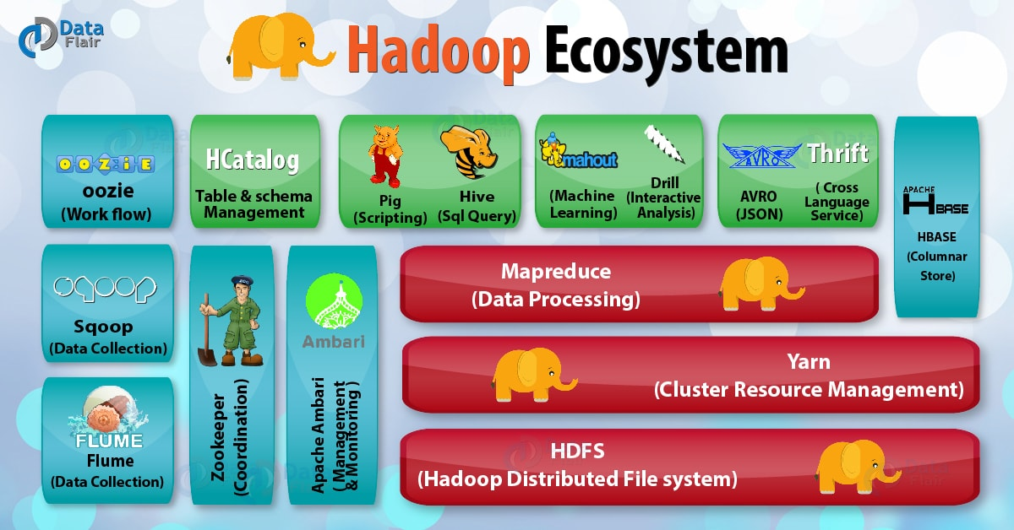

Slide 4
What is Hive?
Hive is a Data Warehousing tool developed by the Apache Software Foundation. Hive is used to query structured data built on top of Hadoop.
Facebook created Hive component to manage its ever-growing volumes of data. Hive makes use of the following:
1. HDFS for Storage
2. MapReduce for execution
3. Stores metadata in an RDBMS.

Slide 5
What is Hive ?
Apache Hive is a popular SQL interface for batch processing on Hadoop.
With the help of SQL methodology and interface, HIVE performs reading and writing of large data sets. However, its query language is called as HQL (Hive Query Language).
It is highly scalable as it allows real-time processing and batch processing both. Also, all the SQL datatypes are supported by Hive thus, making the query processing easier.

Slide 6
Hive - Introduction
Hive provides a query language called HiveQL that closely resembles the common Structured Query Language (SQL) standard.
Hive was one of the earliest project to bring higher-level languages to Apache Hadoop.
Hive is a distributed, fault-tolerant data warehouse system that enables analytics at a massive scale.
Hive also gives structure to Data on HDFS making it data warehousing platform.

Slide 7
History - Hive
Initial released on 1st October, 2010 at Facebook.
Hive was developed by the Facebook Data team and, after being used internally,
it was contributed to the Apache Software Foundation .
Currently Hive is freely available as an open source software from Apache.

Slide 8
What Hive is NOT ?
Hive is not Relational Database, it uses a database to store meta data, but the data that hive processes is stored in HDFS.
Hive is not designed for on-line transaction processing(OLTP).
Hive is not suited for real-time queries and row level updates and it is best used for batch jobs over large sets of immutable data such as web logs.

Slide 9
Hive Components
Similar to the Query Processing frameworks, HIVE too comes with two components:
JDBC Drivers
HIVE Command Line.
JDBC, along with ODBC drivers work on establishing the data storage permissions and connection whereas HIVE Command line helps in the processing of queries.

Slide 10
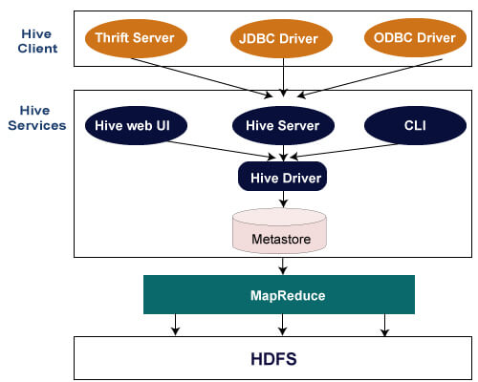

Slide 11
Features of Hive
It is similar to SQL.
HQL is easy to code.
Hive supports rich data types such as structs, lists, and maps.
Hive supports SQL filters, group-by and order-by clauses.

Slide 12
Prerequisites of Hive in Hadoop
The prerequisites for setting up Hive and running queries are
User should have stable build of Hadoop
Machine Should have Java DK 1.6 installed
Basic Java Programming skills
Basic SQL Knowledge
Start all the services of Hadoop using the command $ start-all.sh.
Check all services are running, then use $ hive to start HIVE

Slide 13
Hive Architecture
Hive
Command-Line Interface
Hive Web Interface
Hive Server (Thrift)
Driver (Query Compiler, Executor)
Metastore
JobTracker
TaskTracker
HDFS
Hadoop

Slide 14
Hive Architecture
The various parts are as follows:
Hive Command Line Interface (Hive CLI): The most commonly used interface to interact with Hive.
Hive Web Interface: It is a simple Graphic User Interface to interact with Hive and to execute query.
Hive Server: This is an optional server. This can be used to submit Hive Jobs from a remote client.
JDBC / ODBC: Jobs can be submitted from a JDBC Client. One can write a Java code to connect to Hive and submit jobs on it.

Slide 15
Hive Architecture
Driver: Hive queries are sent to the driver for compilation, optimization and execution.
Metastore: Hive table definitions and mappings to the data are stored in a Metastore. A Metastore consists of the following: 'Metastore service: Offers interface to the Hive. ' Database: Stores data definitions, mappings to the data and others.
The metadata which is stored in the metastore includes IDs of Database, IDs of Tables, IDs of Indexes etc, the time of creation of a Table, the Input Format used for a Table, the Output Format used for a table etc. The metastore is updated whenever a table is created or deleted from Hive. There are three kinds of metastore.

Slide 16
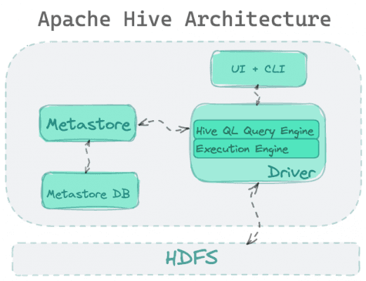
Main components of Hive over HDFS including the UI, Driver, & Metastore

Slide 17
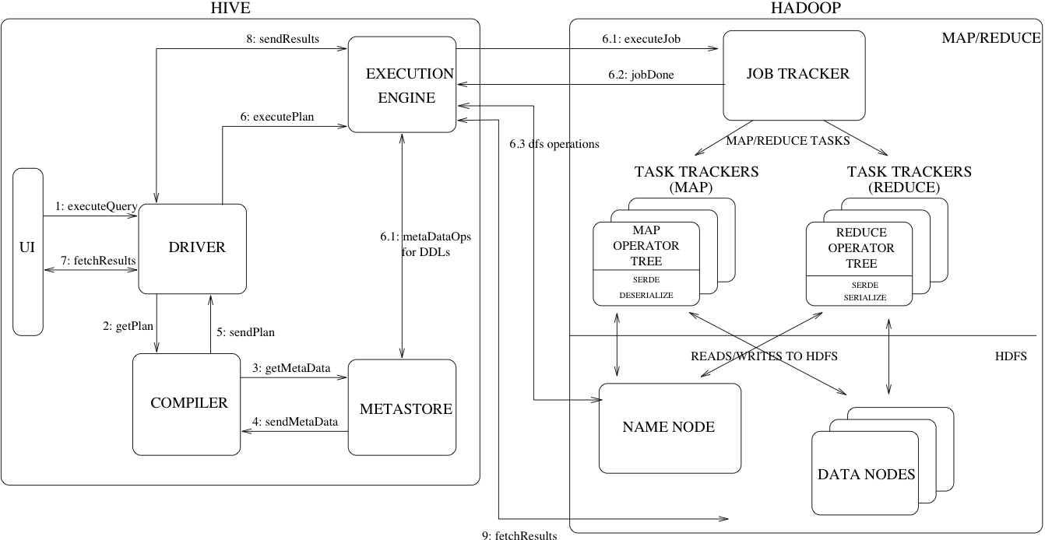

Slide 18
Hive Architecture
1. Embedded Metatore: This metastore is mainly used for unit tests. Here, only one process is allowed to connect to the metastore at a time. This is the default metastore for Hive. It is Apache Derby Database. In this metastore, both the database and the metastore service runs, embedded in the main Hive Server process. Figure 9.8 shows an Embedded Mecastore.
2. Local Metastore: Metadata can be stored in any RDBMS component like MySQL Local metastore allows multiple connections at a time. In this mode, the Hive metastore service runs in the main Hive Server process, but the metastore database runs in a separate process, and can be on a separate host.

Slide 19
Hive Architecture
3. Remote Metastore: In this, the Hive driver and the metastore interface run on different JVMs (which can run on different machines as well) as in Figure 9.10. This way the database can be fire-walled from the Hive user and also database credentials are completely isolated from the users of Hive.

Slide 20
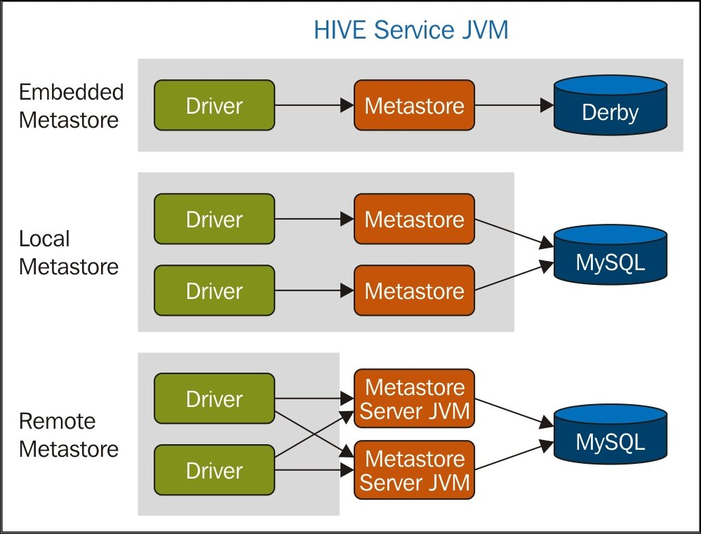

Slide 21
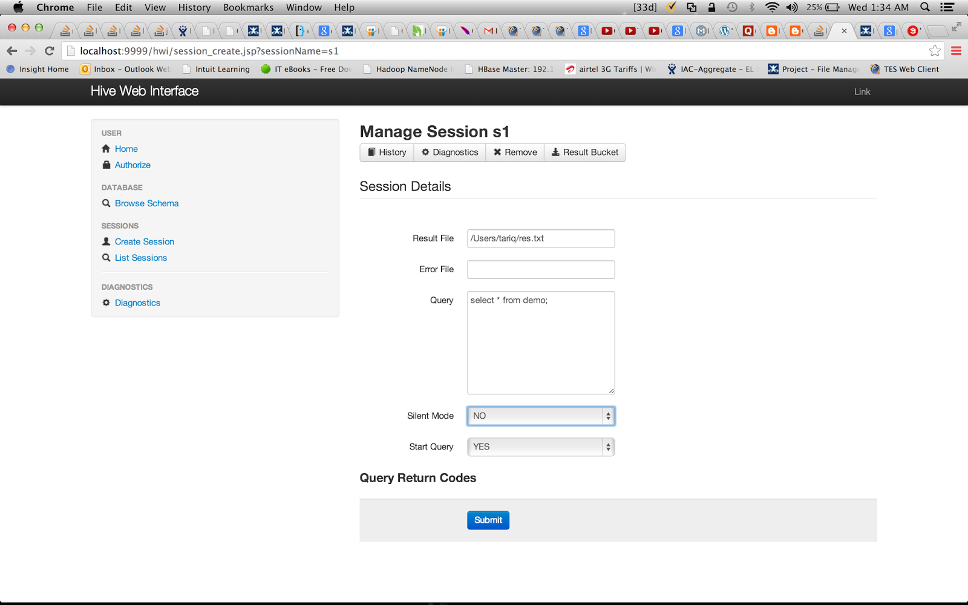

Slide 22
HiveQL
DDL :
CREATE DATABASE
CREATE TABLE
ALTER TABLE
SHOW TABLE
DESCRIBE
DML:
LOAD TABLE
INSERT
QUERY:
SELECT
GROUP BY
JOIN
MULTI TABLE INSERT
Notes:
The EXTERNAL keyword lets you create a table and provide a LOCATION so that Hive does not use a default location for this table. This comes in handy if you already have data generated. When dropping an EXTERNAL table, data in the table is NOT deleted from the file system.

Slide 23
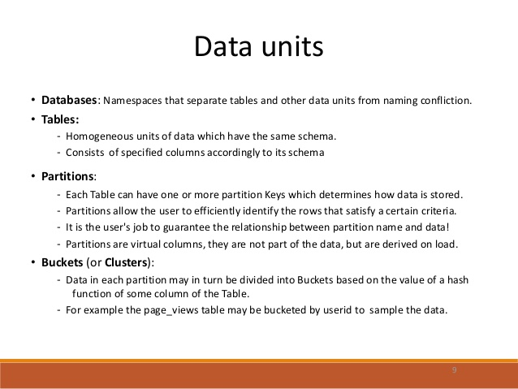
Hive Data Units

Slide 24
Hive Data Model Contd.
Tables
- Analogous to relational tables
Each table has a corresponding directory in HDFS
Data serialized and stored as files within that directory
- Hive has default serialization built in which supports compression and lazy deserialization
- Users can specify custom serialization –deserialization schemes (SerDe’s)

Slide 25
Partition
The general definition of Partition is horizontally dividing the data into number of slice in a equal and manageable manner.
Every partition is stored as directory within data warehouse table.
In data warehouse this partition concept is common but there is two types of Partitions are available in data warehouse concepts.
There are i) SQL Partition ii) Hive Partition

Slide 26
Hive Data Model Contd.
Partitions
Each table can be broken into partitions
Partitions determine distribution of data within subdirectories
Example -
CREATE_TABLE Sales (sale_id INT, amount FLOAT)
PARTITIONED BY (country STRING, year INT, month INT)
So each partition will be split out into different folders like
Sales/country=US/year=2012/month=12

Slide 27
Hierarchy of Hive Partitions
/hivebase/Sales
/country=US
/country=CANADA
/year=2012
/year=2012
/year=2015
/year=2014
/month=12
/month=11
/month=11
File
File
File

Slide 28
Hive Data Model Contd.
Buckets
Data in each partition divided into buckets
Based on a hash function of the column
H(column) mod NumBuckets = bucket number
Each bucket is stored as a file in partition directory

Slide 29
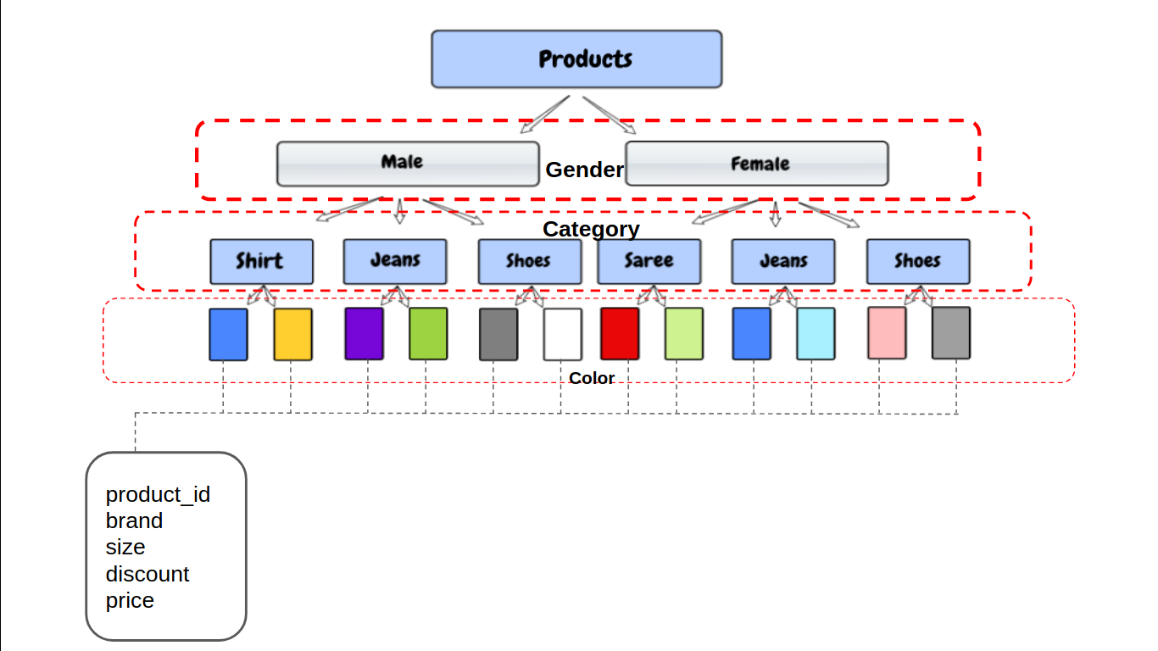

Slide 30
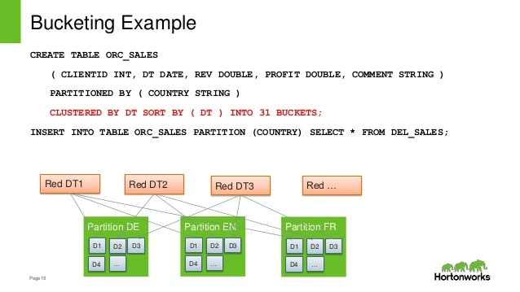

Slide 31
Hive Data Types
Numeric Data Type
TINYINT | 1 - byte signed integer
SMALLINT | 2 -byte signed integer
INT | 4 - byte signed integer
BIGINT | 8 - byte signed integer
FLOAT | 4 - byte single-precision floating-point
DOUBLE | 8 - byte double-precision floating-point number
String Types
STRING
VARCHAR | Only available starting with Hive 0.12.0
CHAR | Only available starting with Hive 0.13.0
Strings can be expressed in either single quotes (‘) or double quotes (“)
Miscellaneous Types
BOOLEAN
BINARY | Only available starting with Hive

Slide 32
Hive Data Types cont..
Collection Data Types
STRUCT | Similar to ‘C’ struct. Fields are accessed using dot notation. E.g.: struct('John', 'Doe')
MAP | A collection of key - value pairs. Fields are accessed using [] notation. E.g.: map('first', 'John', 'last', 'Doe')
ARRAY | Ordered sequence of same types. Fields are accessed using array index. E.g.: array('John', 'Doe')

Slide 33
Hive File Format
Text File: The default file format is text file.
Sequential File: Sequential files are flat files that store binary key-value pairs.
RCFile (Record Columnar File):
RCFile stores the data in Column Oriented Manner which ensures that Aggregation operation is not an expensive operation.

Slide 34
Hive Query Language (HQL)
Works on Databases, Tables, Partitions, Buckets (Clusters)
Create and manage tables and partitions.
Support various Relational, Arithmetic, and Logical Operators.
Evaluate functions.
Downloads the contents of a table to a local directory or result of queries to HDFS directory.

Slide 35
Database
To create a database named “STUDENTS” with comments and database properties.
CREATE DATABASE IF NOT EXISTS STUDENTS COMMENT 'STUDENT Details' WITH DBPROPERTIES ('creator' = 'JOHN');

Slide 36
Database
To describe a database
DESCRIBE DATABASE STUDENTS;
To show Databases
SHOW DATABASES;
To drop database.
DROP DATABASE STUDENTS;

Slide 37
Tables
There are two types of tables in Hive:
Managed table
External table
The difference between two is when you drop a table:
if it is managed table hive deletes both data and meta data,
if it is external table hive only deletes metadata.
Use external keyword to create a external table

Slide 38
Tables
To create managed table named ‘STUDENT’.
CREATE TABLE IF NOT EXISTS STUDENT(rollno INT,name STRING,gpa FLOAT) ROW FORMAT DELIMITED FIELDS TERMINATED BY '\t';

Slide 39
Tables
To create external table named ‘EXT_STUDENT’.
CREATE EXTERNAL TABLE IF NOT EXISTS EXT_STUDENT(rollno INT,name STRING,gpa FLOAT) ROW FORMAT DELIMITED FIELDS TERMINATED BY '\t' LOCATION ‘/STUDENT_INFO;

Slide 40
Tables
To load data into the table from file named student.tsv.
LOAD DATA LOCAL INPATH ‘/root/hivedemos/student.tsv' OVERWRITE INTO TABLE EXT_STUDENT;
To retrieve the student details from “EXT_STUDENT” table.
SELECT * from EXT_STUDENT;

Slide 41
Table ALTER Operations
ALTER TABLE mytablename RENAME to mt;
ALTER TABLE mytable ADD COLOUMNS (mycol STRING);
ALTER TABLE name RENAME TO new_name
ALTER TABLE name DROP [COLUMN] column_name
ALTER TABLE name CHANGE column_name new_name new_type
ALTER TABLE name REPLACE COLUMNS (col_spec[, col_spec ...])

Slide 42
Partitions
Partitions split the larger dataset into more meaningful chunks.
Hive provides two kinds of partitions: Static Partition and Dynamic Partition.
To create static partition based on “gpa” column.
CREATE TABLE IF NOT EXISTS STATIC_PART_STUDENT (rollno INT, name STRING) PARTITIONED BY (gpa FLOAT) ROW FORMAT DELIMITED FIELDS TERMINATED BY '\t';
Load data into partition table from table.
INSERT OVERWRITE TABLE STATIC_PART_STUDENT PARTITION (gpa =4.0) SELECT rollno, name from EXT_STUDENT where gpa=4.0;

Slide 43
Partitions
To create dynamic partition on column date.
CREATE TABLE IF NOT EXISTS DYNAMIC_PART_STUDENT(rollno INT, name STRING) PARTITIONED BY (gpa FLOAT) ROW FORMAT DELIMITED FIELDS TERMINATED BY '\t';
To load data into a dynamic partition table from table.
SET hive.exec.dynamic.partition = true;
SET hive.exec.dynamic.partition.mode = nonstrict;
Note: The dynamic partition strict mode requires at least one static partition column. To turn this off,
set hive.exec.dynamic.partition.mode=nonstrict
INSERT OVERWRITE TABLE DYNAMIC_PART_STUDENT PARTITION (gpa) SELECT rollno,name,gpa from EXT_STUDENT;

Slide 44
Buckets
Tables or partitions are sub-divided into buckets, to provide extra structure to the data that may be used for more efficient querying. Bucketing works based on the value of hash function of some column of a table.
We can add partitions to a table by altering the table. For example, we have a table called employee with fields such as Id, Name, Salary, Designation, Dept, and yoj.

Slide 45
Buckets
To create a bucketed table having 3 buckets.
CREATE TABLE IF NOT EXISTS STUDENT_BUCKET (rollno INT,name STRING,grade FLOAT)
CLUSTERED BY (grade) into 3 buckets;
Load data to bucketed table.
FROM STUDENT
INSERT OVERWRITE TABLE STUDENT_BUCKET
SELECT rollno,name,grade;
To display the content of first bucket.
SELECT DISTINCT GRADE FROM STUDENT_BUCKET
TABLESAMPLE(BUCKET 1 OUT OF 3 ON GRADE);

Slide 46
Aggregations
Hive supports aggregation functions like avg, count, etc.
To write the average and count aggregation function.
SELECT avg(gpa) FROM STUDENT;
SELECT count(*) FROM STUDENT;

Slide 47
Group by and Having
To write group by and having function.
SELECT rollno, name,gpa
FROM STUDENT
GROUP BY rollno,name,gpa
HAVING gpa > 4.0;

